Slide 1
IT267 JAVA MINI PROJECT
Innovative Parking System Solution
23IT102 RUSHIL POPAT
23IT104 NISARG RAMANI
23IT105 SHYAM RAMOLYIA

Slide 2
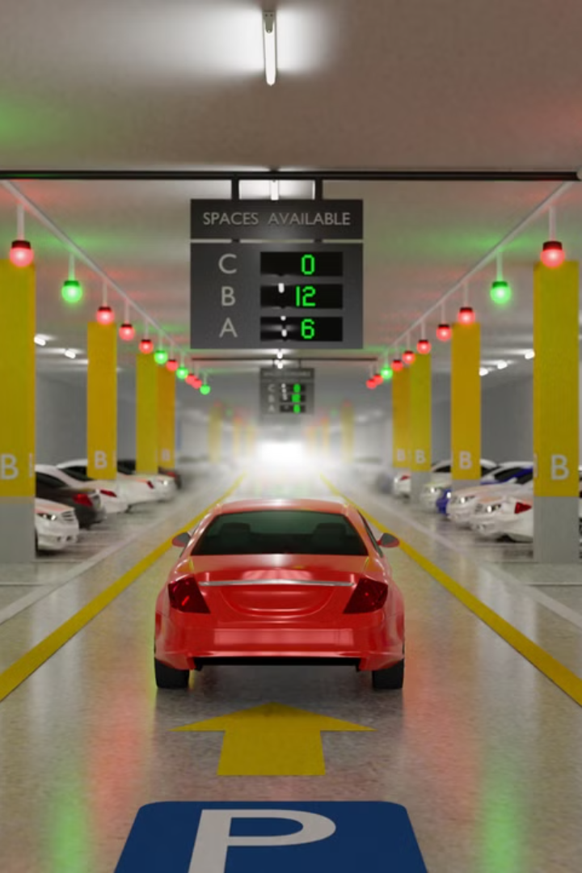
Innovative parking system solutions are transforming the way we think about parking. From sensor-based management to mobile app integration, these systems are making parking more efficient, convenient, and sustainable
Innovative parking system solutions are transforming the way we think about parking. From sensor-based management to mobile app integration, these systems are making parking more efficient, convenient, and sustainable

Slide 3
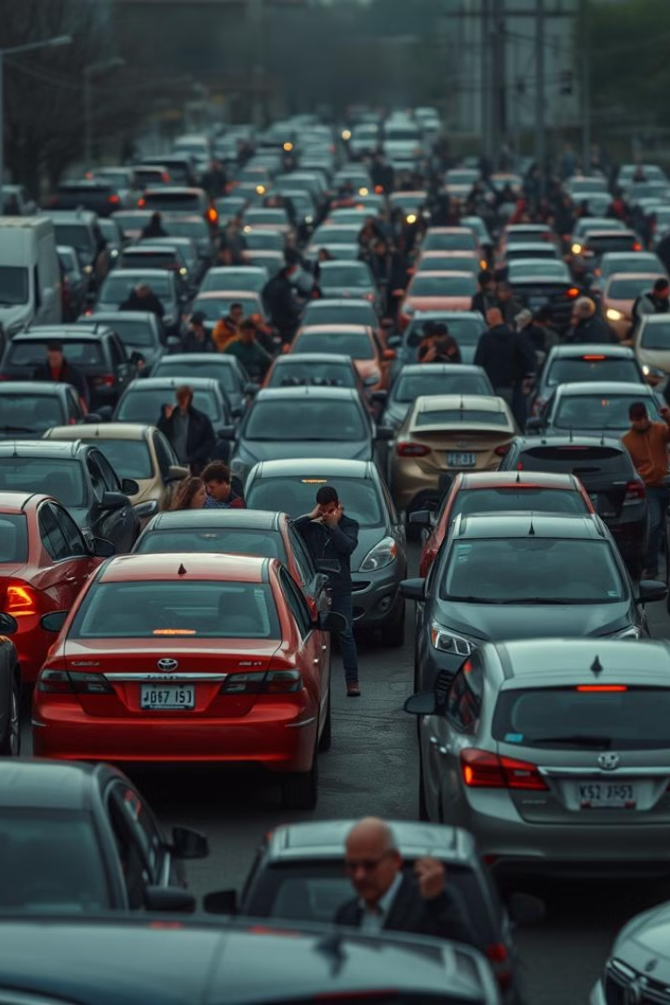
Challenges in Traditional Parking Systems
Traditional parking systems often struggle with issues like limited capacity, inefficient use of space, and lack of real-time information. This can lead to frustrating experiences for drivers and missed revenue opportunities for parking providers.

Slide 4


Slide 5
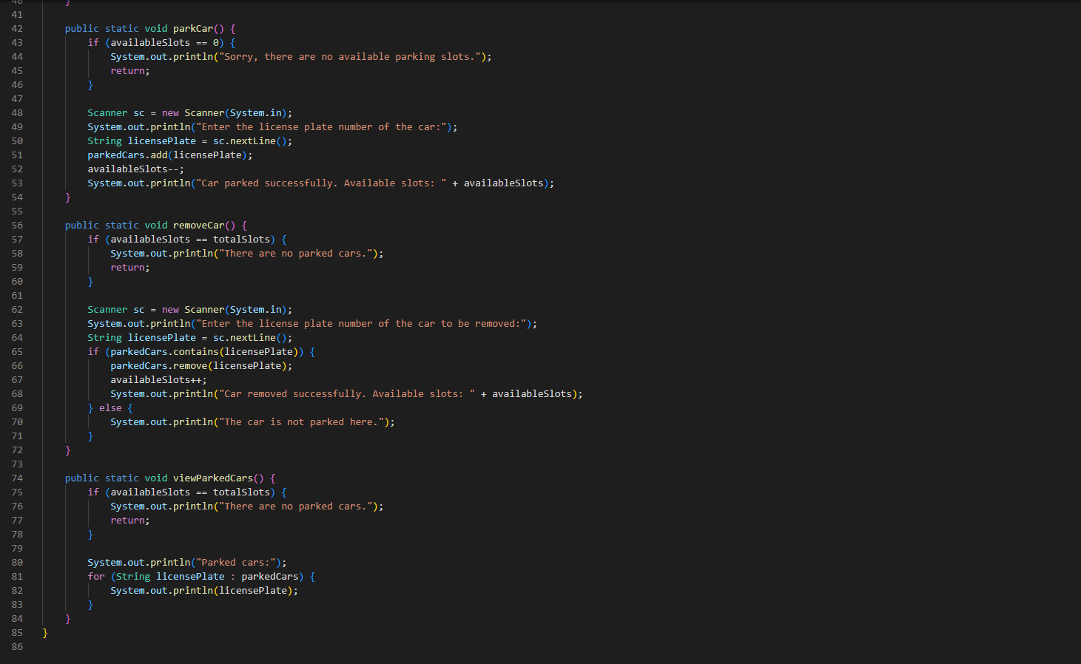

Slide 6
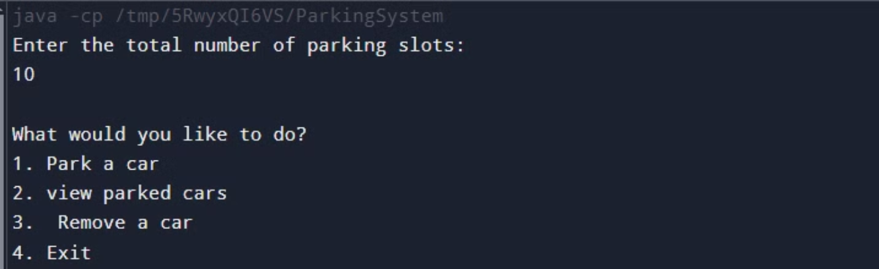
OUTPUT :

Slide 7
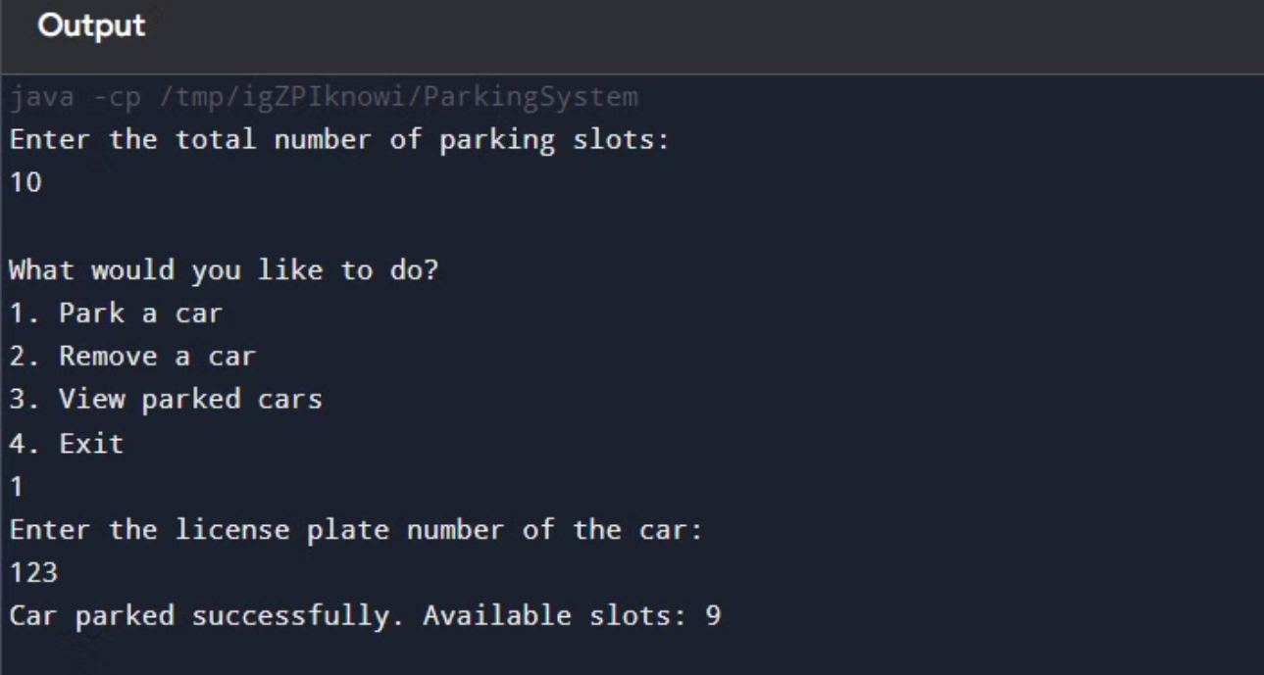
1] PARK A CAR

Slide 8
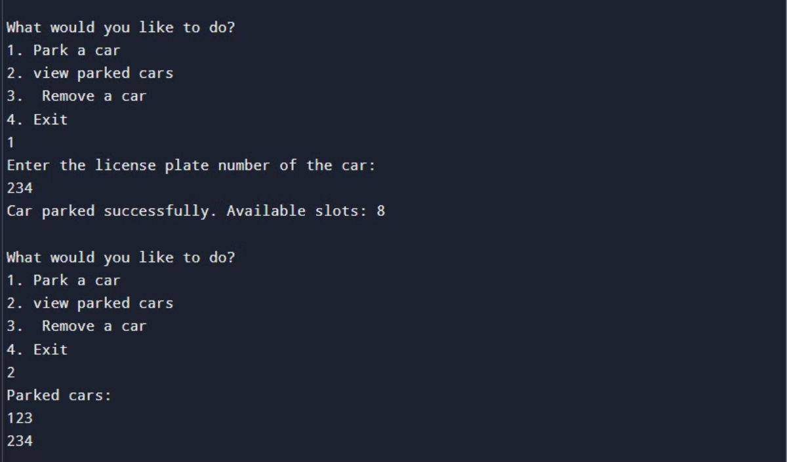
2] VIEW A PARKED CAR

Slide 9
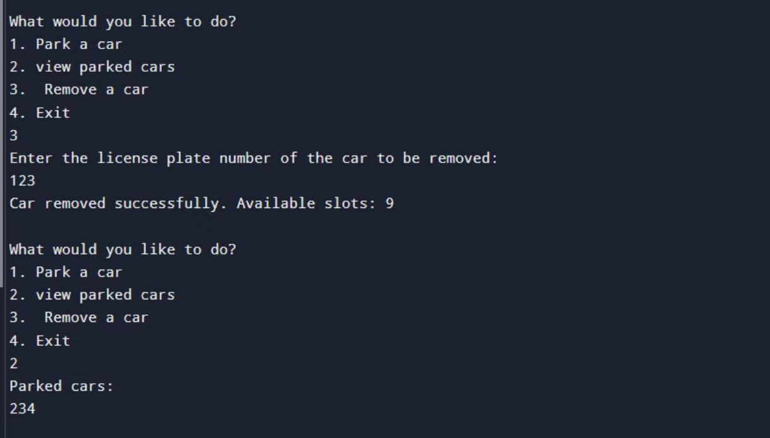
3] REMOVE A CAR

Slide 10
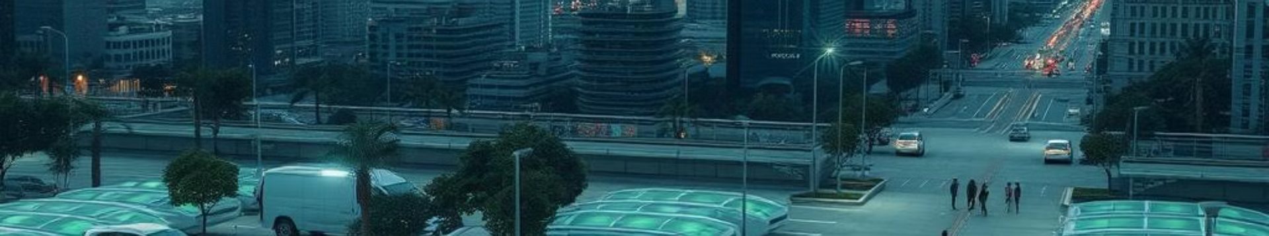



Future Trends in Parking Innovation
Autonomous Parking
Dynamic Pricing
Sustainability Initiatives
Self-driving vehicles will revolutionize how we think about parking, with automated drop-off and retrieval.
Intelligent pricing models will adjust rates based on real-time demand and occupancy data.
Parking facilities will incorporate renewable energy, water conservation, and other eco-friendly features.

Slide 11
THANK YOU

